Slide 1
Design and Analysis of Algorithms
Algorithms-II : CS345A
Lecture 7
Stable Matching Problem: Analysis of the algoirthm
Job scheduling problem

Slide 2
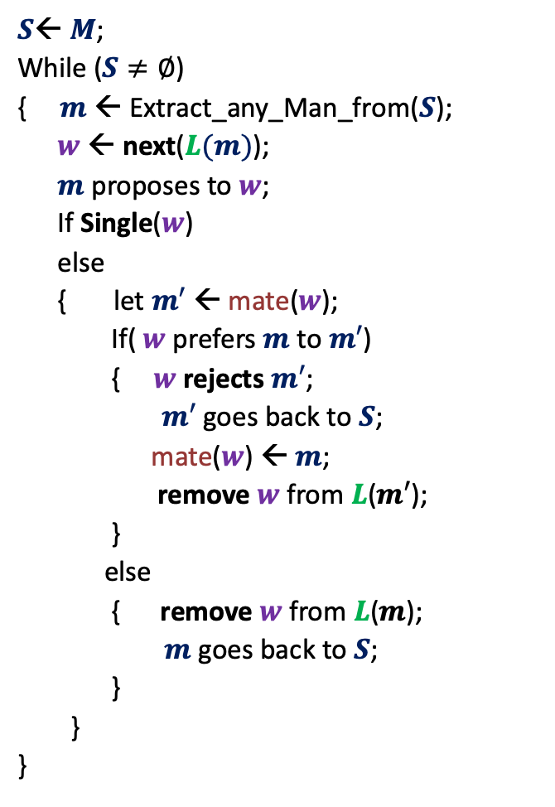



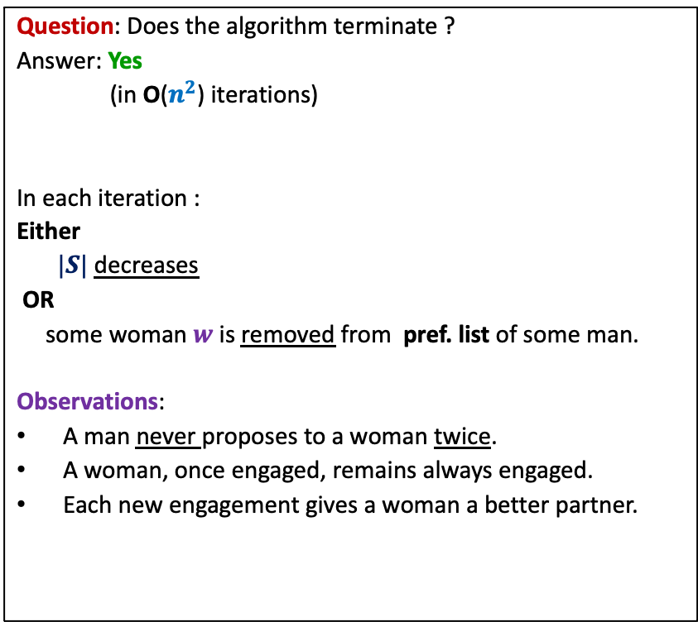
GaleShapley($M$, $W$)
$S$← $M$;
While ($S≠∅$)
{ $m$← Extract_any_Man_from($S$);
$w$ ← next($L(m)$);
$m$ proposes to $w$;
If Single($w$)
else
{ let $m′$ ← mate($w$);
If( $w$ prefers $m$ to $m′$)
{ $w$rejects $m′$;
$m′$ goes back to $S$;
mate($w$) ← $m$;
remove $w$from $L$($m′$);
}
else
{ remove $w$from $L$($m$);
$m$ goes back to $S$;
}
}
}
Question: Does the algorithm terminate ?
Answer: Yes
(in O($n^{2}$) iterations)
In each iteration :
Either
$|S|$ decreases
OR
some woman $w$is removed from pref. list of some man.
Observations:
A man never proposes to a woman twice.
A woman, once engaged, remains always engaged.
Each new engagement gives a woman a better partner.
mate($w$) ← $m$;
Any measure of progress ?
in list $L(w)$, $m$precedes $m′$)

Slide 3






GaleShapley($M$, $W$) (Proof of stability)
There is no unstable pair in the marriage.
How to restate it so that we can prove it easily ?
Lemma :
If $m_{j}$ prefers $w_{l}$ to $w_{i}$
➔ $w_{l}$ prefers $m_{k}$ to $m_{j}$.
$$w_{l}$$
$$m_{k}$$
$$w_{i}$$
$$m_{j}$$
Proof was discussed interactively during the class.
The key observation used in the proof was:
Each new engagement gives a woman a better partner (mate).

Slide 4
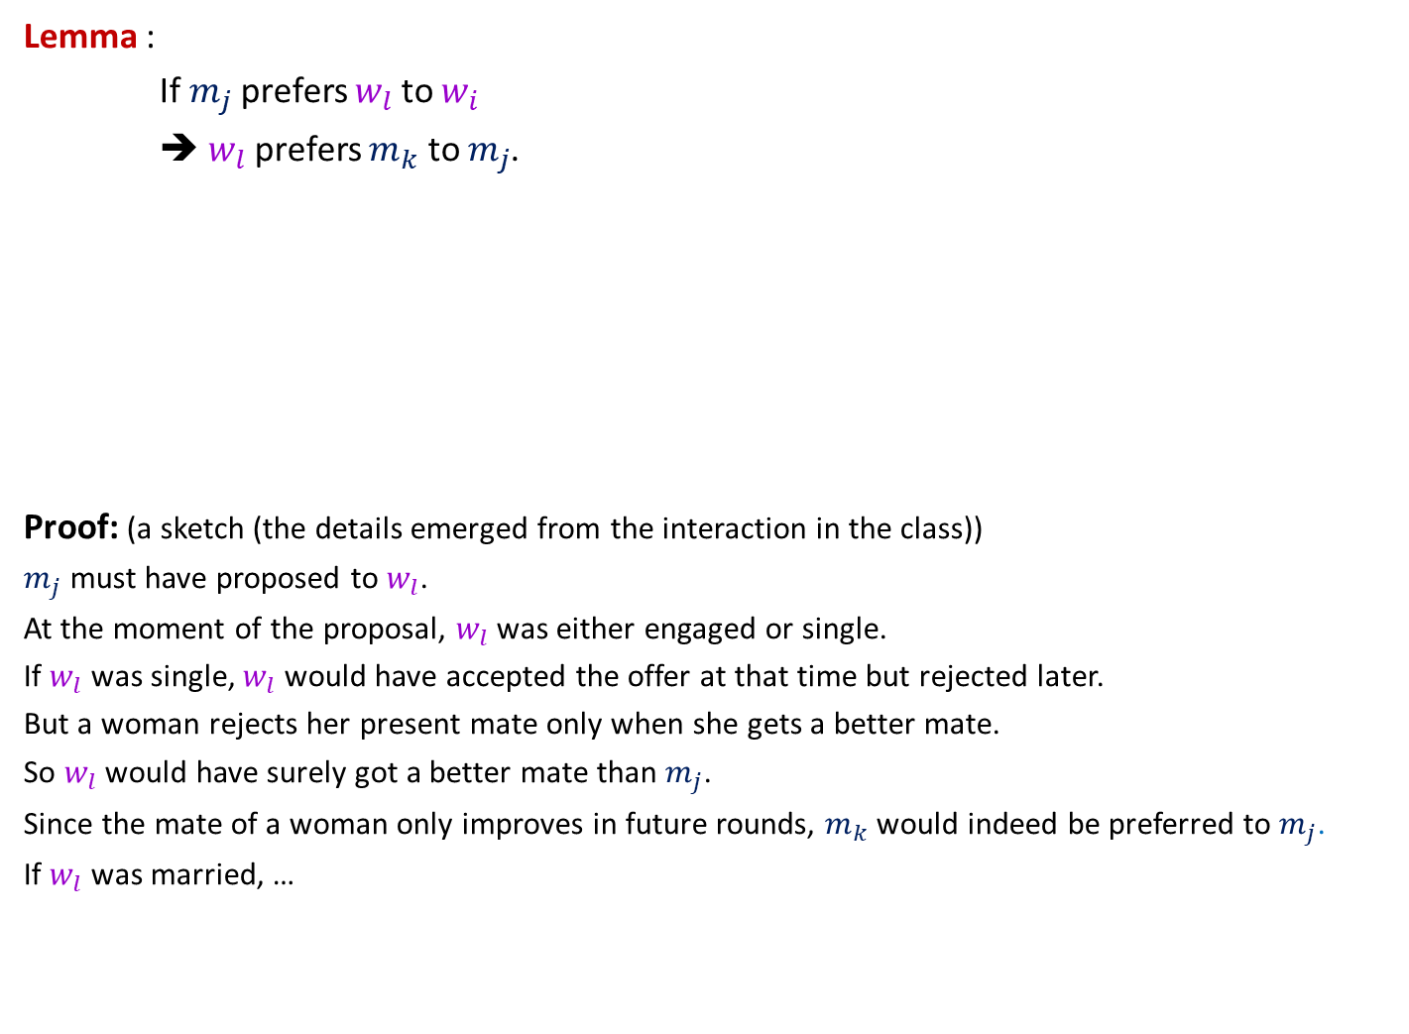
GaleShapley($M$, $W$) (Proof of stability)
Lemma :
If $m_{j}$ prefers $w_{l}$ to $w_{i}$
➔ $w_{l}$ prefers $m_{k}$ to $m_{j}$.
Proof: (a sketch (the details emerged from the interaction in the class))
$m_{j}$ must have proposed to $w_{l}$.
At the moment of the proposal, $w_{l}$ was either engaged or single.
If $w_{l}$ was single, $w_{l}$ would have accepted the offer at that time but rejected later.
But a woman rejects her present mate only when she gets a better mate.
So $w_{l}$ would have surely got a better mate than $m_{j}$.
Since the mate of a woman only improves in future rounds, $m_{k}$would indeed be preferred to $m_{j}$.
If $w_{l}$ was married, …
$$w_{l}$$
$$m_{k}$$
$$w_{i}$$
$$m_{j}$$

Slide 5


$$m_{t}$$
$$w_{l}$$
$$m_{k}$$
$$w_{i}$$
$$m_{j}$$
$$m_{p}$$

Slide 6


GaleShapley($M$, $W$) (Proof of stability)
Lemma : If $m_{j}$ prefers $w_{l}$ to $w_{i}$
➔ $w_{l}$ prefers $m_{k}$ to $m_{j}$.
$$w_{l}$$
$$m_{k}$$
$$w_{i}$$
$$m_{j}$$

Slide 7
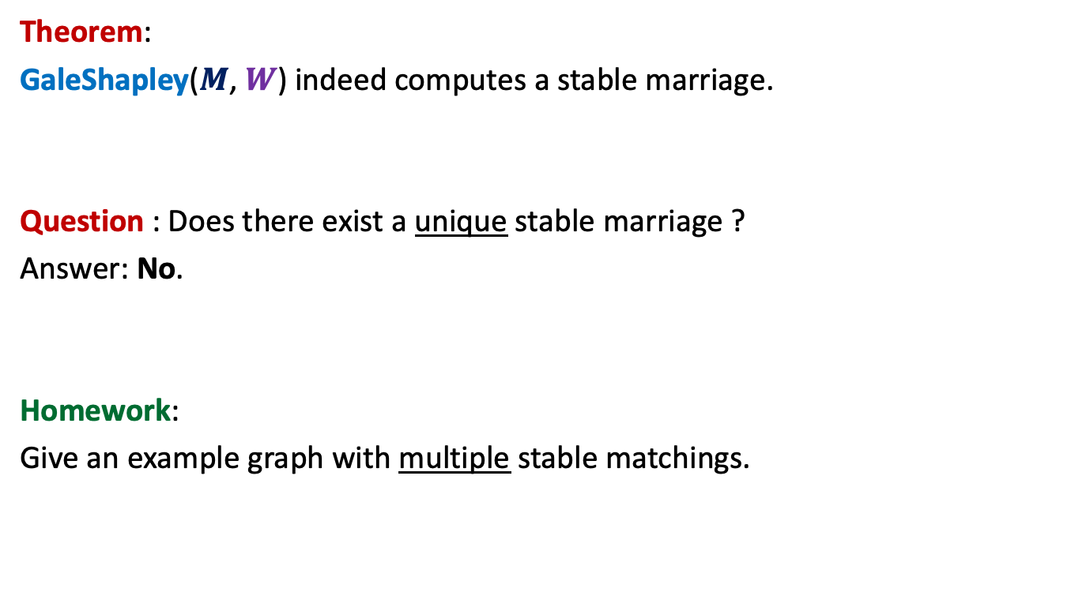
GaleShapley($M$, $W$)
Theorem:
GaleShapley($M$, $W$) indeed computes a stable marriage.
Question : Does there exist a unique stable marriage ?
Answer: No.
Homework:
Give an example graph with multiple stable matchings.

Slide 8


Gale Shapley Algorithm
Theorem:
There cannot exist any other stable matching
that matches a man to a better woman.
Man proposing
Woman pessimal
Man Optimal

Slide 9
Gale Shapley Algorithm
Woman proposing
Woman Optimal
Man Pessimal
Homework: Provide a neat, simple, and intuitive proof for the theorem
The proof is not part of the syllabus for Quiz 1. So feel relaxed ☺
Enthusiastic students may submit the proof to the instructor in the class on 21st August.

Slide 10
Gayle Shapley Algorithm
Man-Proposing version
Proof of Man optimality

Slide 11
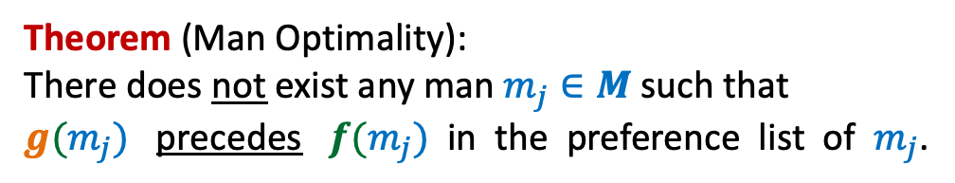

Let $f: M→W$be the matching produced by GS algorithm.
Let $g:M→W$ be any other stable matching.
Theorem (Man Optimality):
There does not exist any man $m_{j}∈M$such that
$g(m_{j})$ precedes $f(m_{j})$ in the preference list of $m_{j}$.

Slide 12
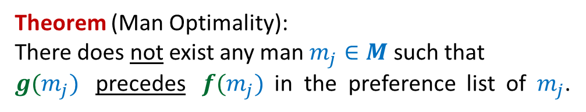

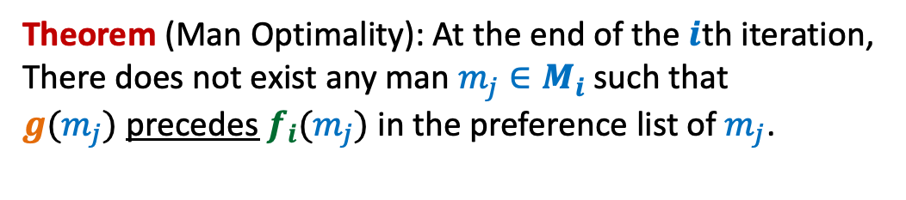
Theorem (Man Optimality):
There does not exist any man $m_{j}∈M$such that
$g(m_{j})$ precedes $f(m_{j})$ in the preference list of $m_{j}$.
At the end of the $i$th iteration,
$M_{i}:$ the set of men matched by GS algorithm.
$f_{i} :M_{i}→W$
Theorem (Man Optimality): At the end of the $i$th iteration,
There does not exist any man $m_{j}∈M_{i}$such that
$g(m_{j})$ precedes $f_{i}(m_{j})$ in the preference list of $m_{j}$.

Slide 13
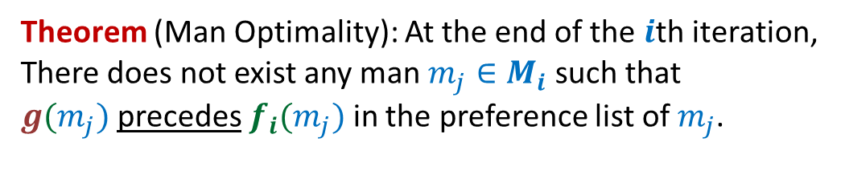


Theorem (Man Optimality): At the end of the $i$th iteration,
There does not exist any man $m_{j}∈M_{i}$such that
$g(m_{j})$ precedes $f_{i}(m_{j})$ in the preference list of $m_{j}$.
$$f_{i}$$
$$g$$

Slide 14

Theorem (Man Optimality): At the end of the $i$th iteration,
There does not exist any man $m_{j}∈M_{i}$such that
$g(m_{j})$ precedes $f_{i}(m_{j})$ in the preference list of $m_{j}$.
1st Iteration
$$f_{1}$$
$$g$$

Slide 15





Theorem (Man Optimality): At the end of the $i$th iteration,
There does not exist any man $m_{j}∈M_{i}$such that
$g(m_{j})$ precedes $f_{i}(m_{j})$ in the preference list of $m_{j}$.
$(i−1)$th iteration:
Execution of $i$th iteration:
$$f_{i−1}$$
$$m_{j}$$
$$g$$

Slide 16








Theorem (Man Optimality): At the end of the $i$th iteration,
There does not exist any man $m_{j}∈M_{i}$such that
$g(m_{j})$ precedes $f_{i}(m_{j})$ in the preference list of $m_{j}$.
Execution of $i$th iteration:
$$w_{j′}$$
$$m_{k}$$
$$w_{p}$$
$$m_{k}$$
$$w_{j}$$
$$m_{j}$$
$$f_{i}$$
$$w_{j′}$$
$$m_{j}$$
$g$ is not stable matching
Pratham Sahu gave an alternate proof.
I am posting that proof (pdf file)on the
course website below this lecture.
$$g$$

Slide 17









Gale Shapley Algorithm
Ponder over the connection between Gale Shapley Algorithm and Joint Seat Allocation.
Women
Men
$$w_{1}$$
$$m_{1}$$
$$w_{2}$$
$$m_{2}$$
$$w_{3}$$
$$m_{3}$$
$$w_{i}$$
$$m_{j}$$
$$w_{n}$$
$$m_{n}$$

Slide 18
A Job scheduling problem

Slide 19





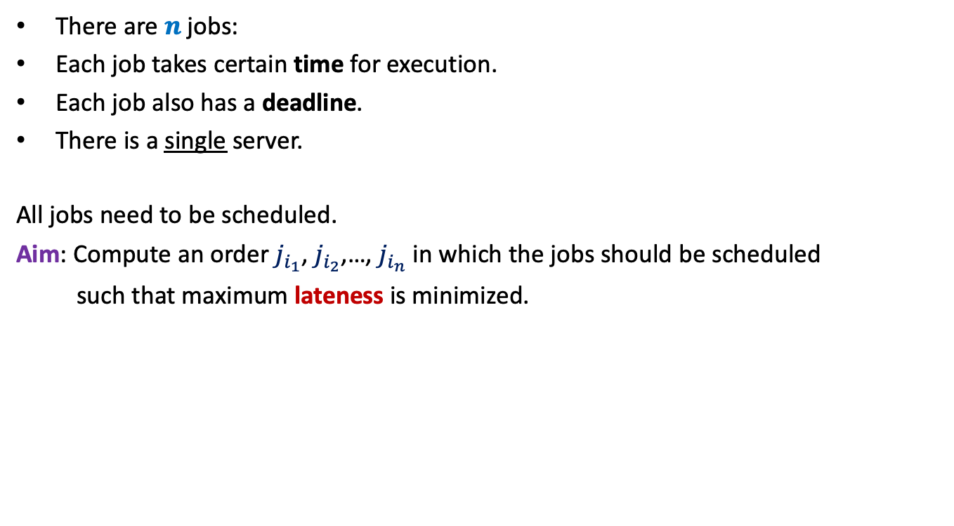








There are $n$ jobs:
Each job takes certain time for execution.
Each job also has a deadline.
There is a single server.
All jobs need to be scheduled.
Aim: Compute an order $j_{i_{1}}$, $j_{i_{2}}$,…, $j_{i_{n}}$ in which the jobs should be scheduled
such that maximum lateness is minimized.
$j_{1}$, $j_{2}$,…, $j_{n}$
Job $j_{i}$ takes $t_{i}$ time
Job $j_{i}$ has deadline $d_{i}$
$$f_{i_{k}}$$
$$d_{i_{k}}$$
$$d_{i_{k}}$$
Lateness of $j_{i_{k}}$
$$j_{i_{1}}$$
$$j_{i_{2}}$$
$$j_{i_{3}}$$
$$j_{i_{k}}$$
$$j_{i_{n}}$$
$$0$$
time

Slide 20

Towards designing an algorithm
Each job $j_{i}$ has two parameters
Time of execution $t_{i}$
Deadline $d_{i}$
Idea 1: Schedule the jobs in the increasing order of Time of execution.
Try to prove correctness
Try to come up with a counter example

Slide 21





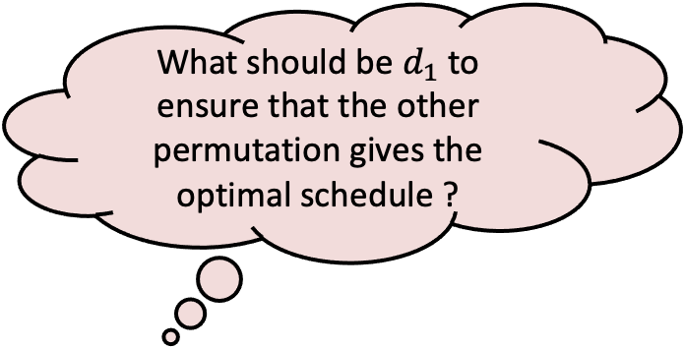


Towards designing a counterexample
Let us consider only 2 jobs.
What should be $d_{1}$ to ensure that the other permutation gives the optimal schedule ?
$$t_{1}$$
$$j_{1}$$
$$t_{2}$$
$$j_{2}$$
$$d_{2}$$
$$j_{1}$$
$$j_{2}$$
time

Slide 22

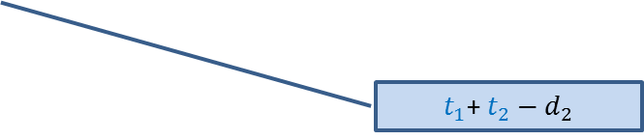

Towards designing a counterexample
Towards designing an algorithm
The job with farther deadline should be scheduled later.
the job with earlier deadline should be scheduled first.
$$t_{1}$$
This counterexample hints at a very important point as well.
$$j_{1}$$
?
$$d_{1}$$
$$t_{2}$$
$t_{1}$+ $t_{2}−d_{1}$
$$j_{2}$$
?
$$d_{2}$$
$t_{1}$+ $t_{2}−d_{2}$
$$j_{1}$$
$$j_{2}$$
time

Slide 23
How to schedule more than 2 jobs ?
time
$$0$$

Slide 24
How to schedule more than 2 jobs ?
All other jobs remain unaffected.
The maximum lateness for these 2 jobs
Can only reduce.
What happens if we just swap these 2 jobs only.
Idea 2:
Homework:
Write a neat pseudocode of an efficient algorithm for this problem.
Write a formal proof of correctness of the algorithm.
time
$$0$$
Schedule the jobs in increasing order of their deadlines.

